Slide 1
CS2106 Tutorial 2
T01/T02

Slide 2
Quick Recap

Slide 3
fork()
fork() creates a new process by duplicating the calling process. The new process is referred to as the child process. The calling process is referred to as the parent process.
Return Value:
On success, parent process gets the PID of the child process, child process gets 0.
On failure, parent process gets -1, no child process is created.

Slide 4
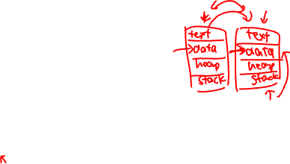
More on fork()
The entire virtual address space of the parent is replicated in the child
The child process and the parent process run in separate memory spaces.
Both parent and child processes continue executing after fork()
PC is also duplicated in child process
Use the return value of fork() to distinguish parent and child
Parent process: if (pid != 0)
Child process: if (pid == 0)

Slide 5
exec()
exec() replaces current executing image with a new one.
Return only if an error has occurred.

Slide 6
fork() + exec()
By combining the two mechanisms, we can:
Spawn off a child process
Let the child process perform a task through exec()
Meanwhile, the parent process is still around
To accept another request
This combination of mechanisms is the main way in Unix:
To get a new process for running a new program

Slide 7
exit()
exit() causes normal process termination
Status is returned to the parent process
0 = Normal Termination (successful execution)
!0 = To indicate problematic execution
The function does not return

Slide 8
More on exit()
main() implicitly calls exit()
Most system resources used by process are released on exit()
E.g. File descriptors
Some basic process resources are not releasable
E.g. PID & process status
Process control block may be still needed

Slide 9

wait()
wait() suspends the calling thread until one of its children terminates.
waitpid() suspends the calling process until a child specified by pid argument has changed state.
wait() allows the calling process to release the resources associated with the child; if it is not performed, then the terminated child remains in a zombie state.
On success, returns the process ID of the terminated child; on error, -1 is returned.

Slide 10
More on wait()
If there are no children, wait() does not block (as stated in question 1). Process will just continue running
Cleans up remainder of child resources

Slide 11

Zombie and Orphan
Zombie: Child terminates before parent but parent did not call wait()
Child process become a zombie process
Can exhaust process table
Orphan: Parent terminates before child
init() process becomes pseudo parent of child process
init() uses wait() to clean up child process

Slide 12
More on zombies
Data such as exit status may be needed, so process entry will be kept in PCB
Process always has a parent
If the parent terminated, init will become the pseudo-parent and help to clean

Slide 13
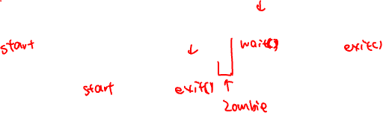
Some cases for wait() and zombies
Parent
Parent
Parent
Child
Child

Slide 14
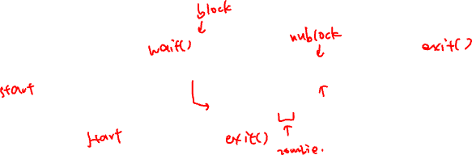
Some cases for wait() and zombies
Parent
Parent
Parent
Parent
Child
Child

Slide 15
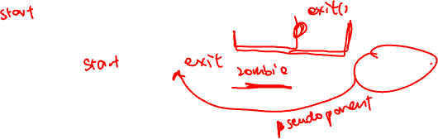
Some cases for wait() and zombies
Parent
Parent
Child
Child
init

Slide 16
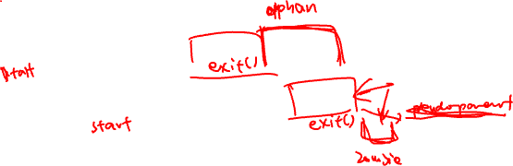
Some cases for wait() and zombies
Parent
Parent
Child
Child
init

Slide 17
Tutorial Questions

Slide 18
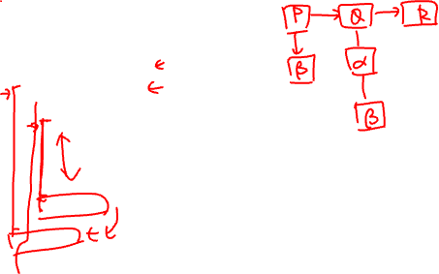
Question 1
int main( ) {
// This is process P
if ( fork() == 0 ){
// This is process Q
if ( fork() == 0 ) {
// This is process R
......
return 0;
}
<Point α>
}
<Point β>
return 0;
}

Slide 19
Question 1
P
Q
R
int main( ) {
// This is process P
if ( fork() == 0 ){
// This is process Q
if ( fork() == 0 ) {
// This is process R
......
return 0;
}
<Point α>
}
<Point β>
return 0;
}
α
β
β

Slide 20
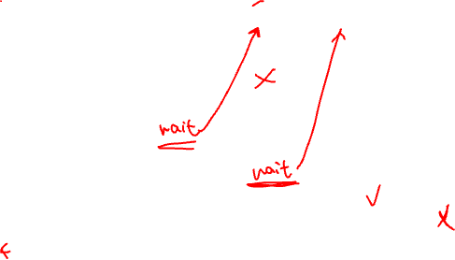
Question 1a
P
Q
R
int main( ) {
// This is process P
if ( fork() == 0 ){
// This is process Q
if ( fork() == 0 ) {
// This is process R
......
return 0;
}
<nothing>
}
wait(NULL);
return 0;
}
α
β
β
Process Q always terminate before P.
Process R can terminate at any time w.r.t. P and Q.

Slide 21
Question 1a
P
Q
R
int main( ) {
// This is process P
if ( fork() == 0 ){
// This is process Q
if ( fork() == 0 ) {
// This is process R
......
return 0;
}
<nothing>
}
wait(NULL);
return 0;
}
α
β
β
Process Q always terminate before P.
Process R can terminate at any time w.r.t. P and Q.
False: Q waits for R

Slide 22
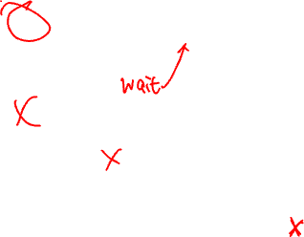
Question 1b
P
Q
R
int main( ) {
// This is process P
if ( fork() == 0 ){
// This is process Q
if ( fork() == 0 ) {
// This is process R
......
return 0;
}
wait(NULL);
}
<nothing>
return 0;
}
α
β
β
Process Q always terminate before P.
Process R can terminate at any time w.r.t. P and Q.

Slide 23
Question 1b
P
Q
R
int main( ) {
// This is process P
if ( fork() == 0 ){
// This is process Q
if ( fork() == 0 ) {
// This is process R
......
return 0;
}
wait(NULL);
}
<nothing>
return 0;
}
α
β
β
Process Q always terminate before P.
Process R can terminate at any time w.r.t. P and Q.
False: Q waits for R and P don’t wait

Slide 24
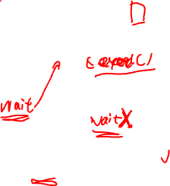
Question 1c
P
Q
R
int main( ) {
// This is process P
if ( fork() == 0 ){
// This is process Q
if ( fork() == 0 ) {
// This is process R
......
return 0;
}
execl(..);
}
wait(NULL);
return 0;
}
α
β
β
Process Q always terminate before P.
Process R can terminate at any time w.r.t. P and Q.

Slide 25
Question 1c
P
Q
R
int main( ) {
// This is process P
if ( fork() == 0 ){
// This is process Q
if ( fork() == 0 ) {
// This is process R
......
return 0;
}
execl(..);
}
wait(NULL);
return 0;
}
α
β
β
Process Q always terminate before P.
Process R can terminate at any time w.r.t. P and Q.
True: P wait for Q even though Q is now a "new" executable.
Q doesn’t wait because execl() replace the entire context (text, data, heap, stack)

Slide 26
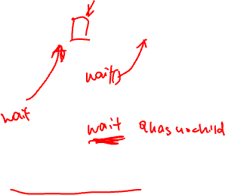
Question 1d
P
Q
R
int main( ) {
// This is process P
if ( fork() == 0 ){
// This is process Q
if ( fork() == 0 ) {
// This is process R
......
return 0;
}
wait(NULL);
}
wait(NULL);
return 0;
}
α
β
β
Process P never terminates.

Slide 27
Question 1d
P
Q
R
int main( ) {
// This is process P
if ( fork() == 0 ){
// This is process Q
if ( fork() == 0 ) {
// This is process R
......
return 0;
}
wait(NULL);
}
wait(NULL);
return 0;
}
α
β
β
Process P never terminates.
False: Although Q has an additional wait, the wait will return immediately as there is no child.
wait() doesn’t block on grand children.

Slide 28
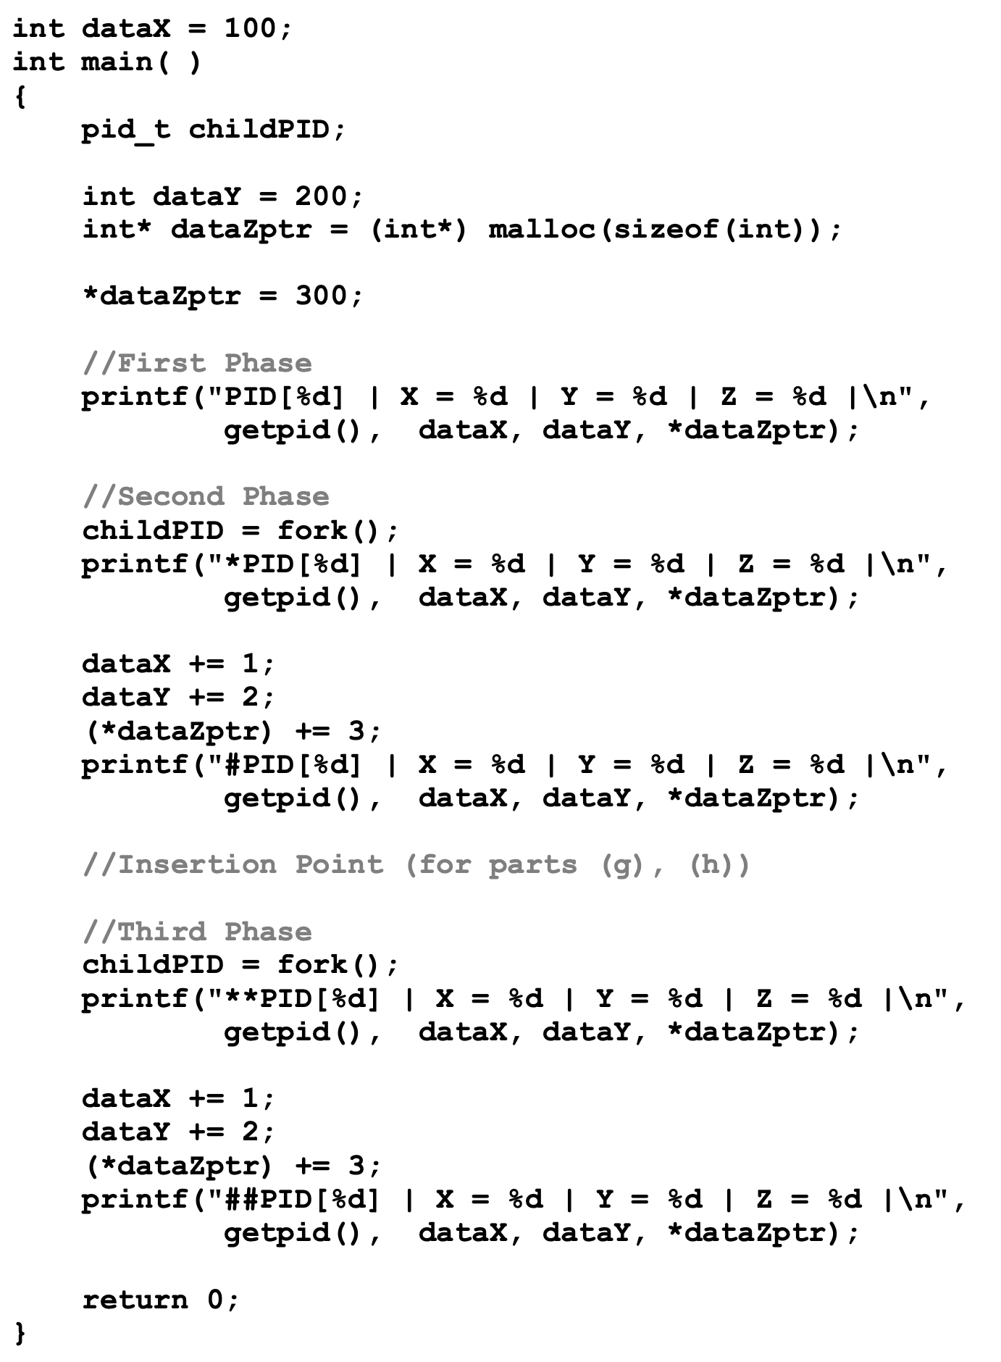
Question 2

Slide 29
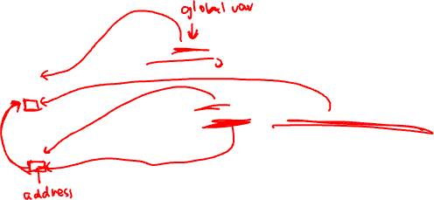
Question 2a
Text
Data
Heap
Stack

Slide 30





Question 2a
Text
Data
Heap
Stack

Slide 31
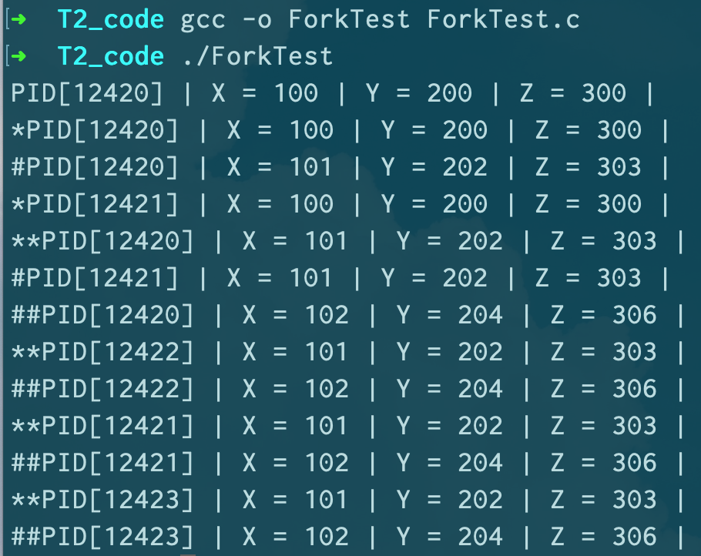

Question 2b

Slide 32

Question 2b
Every process in the same phase prints out the same values.
Once the process begins, each process is running completely independently of the others from when it begins to when it exits.

Slide 33
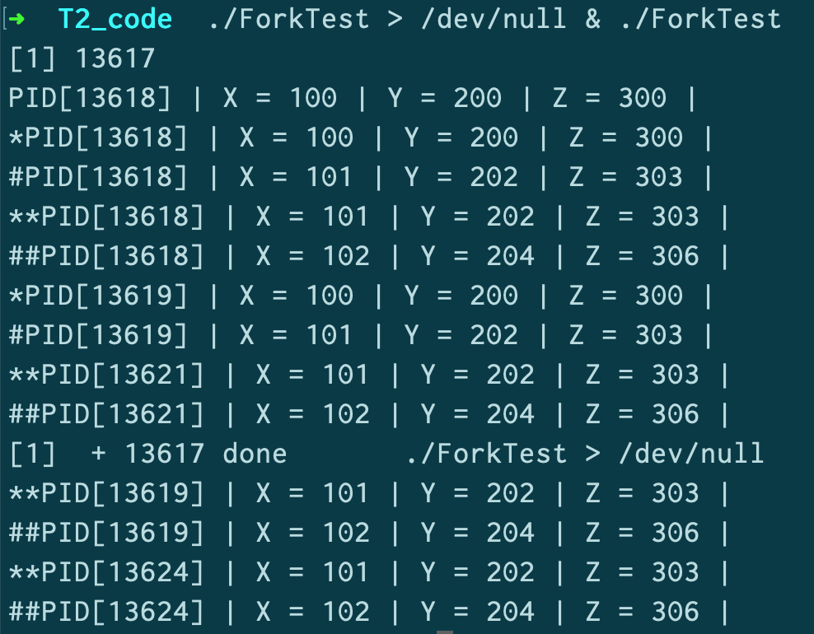
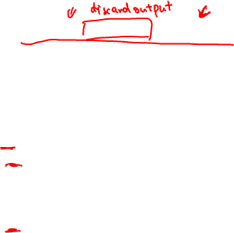
Question 2b
The PIDs appear to be assigned sequentially, but it depends on the number of new processes being created at the same time.

Slide 34
Question 2c

Slide 35
Question 2c
All 3 data items are duplicated.
Both the parent and child process has the same values after fork().
Parent & child have independent memory space.
Updates do not impact each other's memory space.

Slide 36
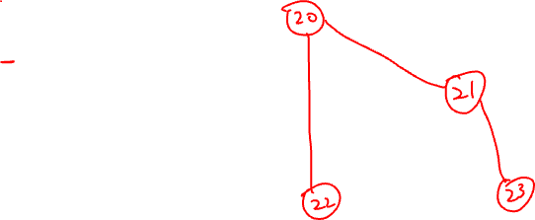
Question 2d
First Phase
Second Phase
Third Phase

Slide 37
Question 2d
First Phase
Second Phase
Third Phase
12420
12421
12422
12423
Note that all 4 processes are alive at the last stage.

Slide 38
Question 2e
Is it possible to get different ordering between the output messages?

Slide 39
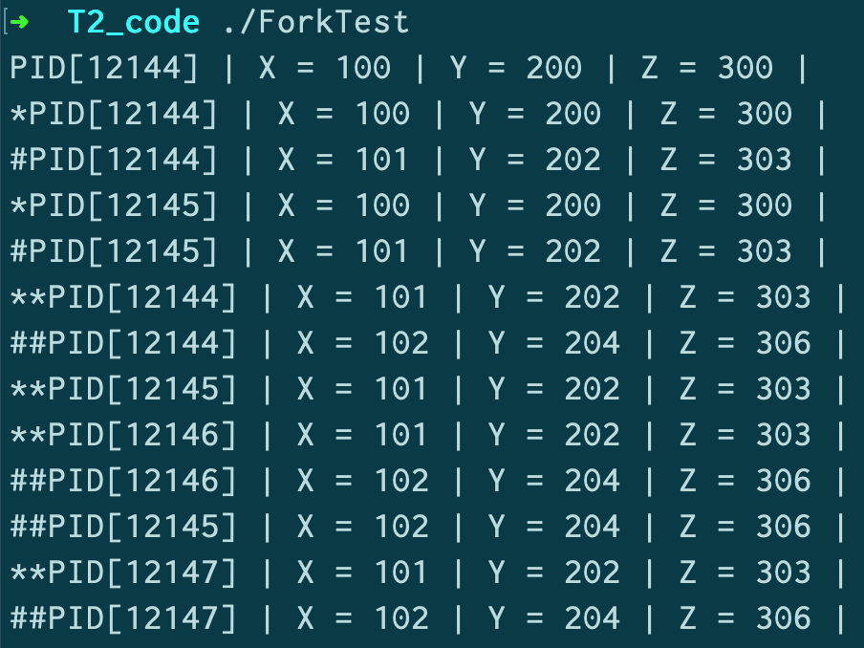
Question 2e
Yes.
Once the processes are created, they can be independently chosen by the OS to run.
Depending on the existence of other processes at that time, it is possible that OS choose differently between runs of the program.
Is it possible to get different ordering between the output messages?

Slide 40
Question 2f
Which messages can never swap places?

Slide 41
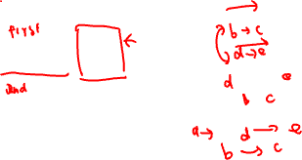
Question 2f
Which messages can never swap places?
P1
P2
a
fork()
d
b
e
c

Slide 42
Question 2f
"*" and "#" messages from the same process can never change place as sequential ordering is still preserved in the same process.
Likewise, messages from the same process will always follow the phases, i.e. "*", "#" before "**" and "##".
Message from the first phase (only one) must precede all other messages. This is obviously correct as there is only one process executing at that time.
Which messages can never swap places?
P1
P2
a
fork()
d
b
e
c

Slide 43
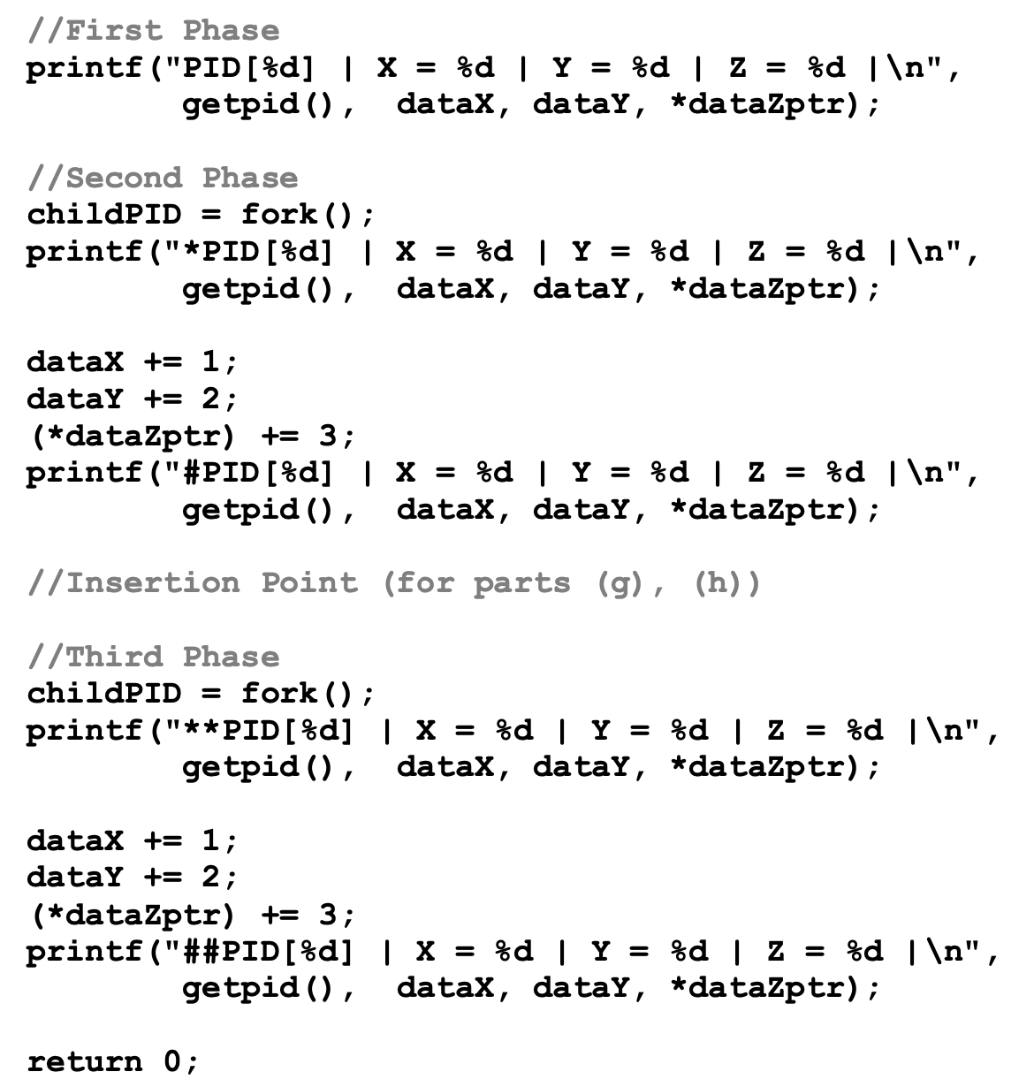
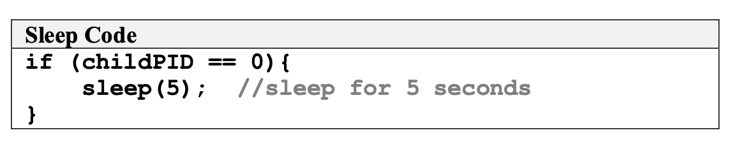
Question 2g

Slide 44


Question 2g
First Phase
Second Phase
Third Phase
12420
12421
12422
12423

Slide 45

Question 2g
First Phase
Second Phase
Third Phase
12420
12421
12422
12423
Possible scenario: both 12420 and 12422 terminates before 12421 wakes up

Slide 46
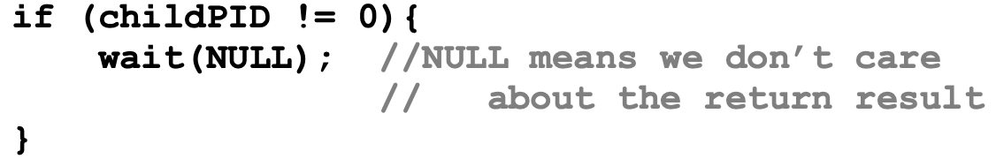
Question 2h

Slide 47
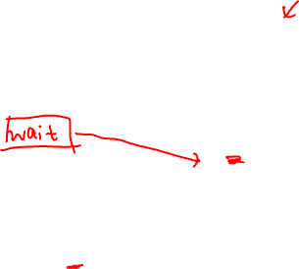
Question 2h
First Phase
Second Phase
Third Phase
12420
12421
12422
12423

Slide 48

Question 2h
First Phase
Second Phase
Third Phase
12420
12421
12422
12423
Fixed behaviour: all messages from 12421 must be printed before process 12420 and subsequently 12422 can be printed.

Slide 49
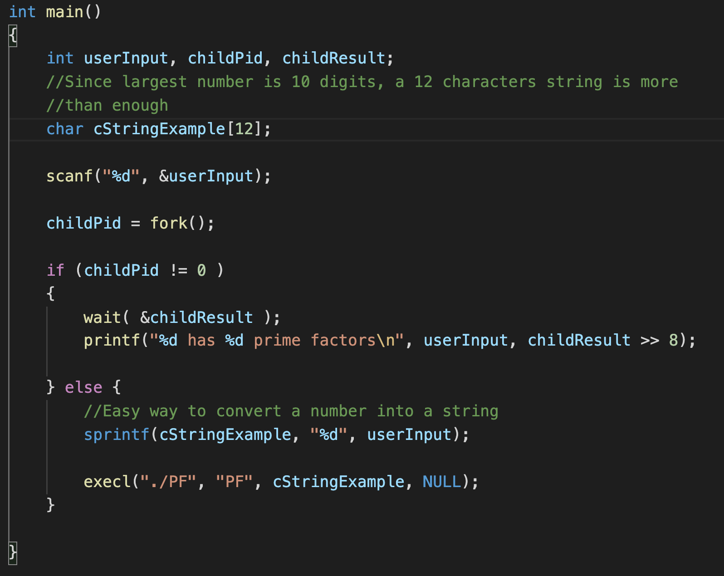
Question 3
PrimeFactors.c
Prime factorisation program
Compile to PF (executable, run by calling ./PF)
Parallel.c (on the right)
Use fork() and execl() to run PF (executable)

Slide 50
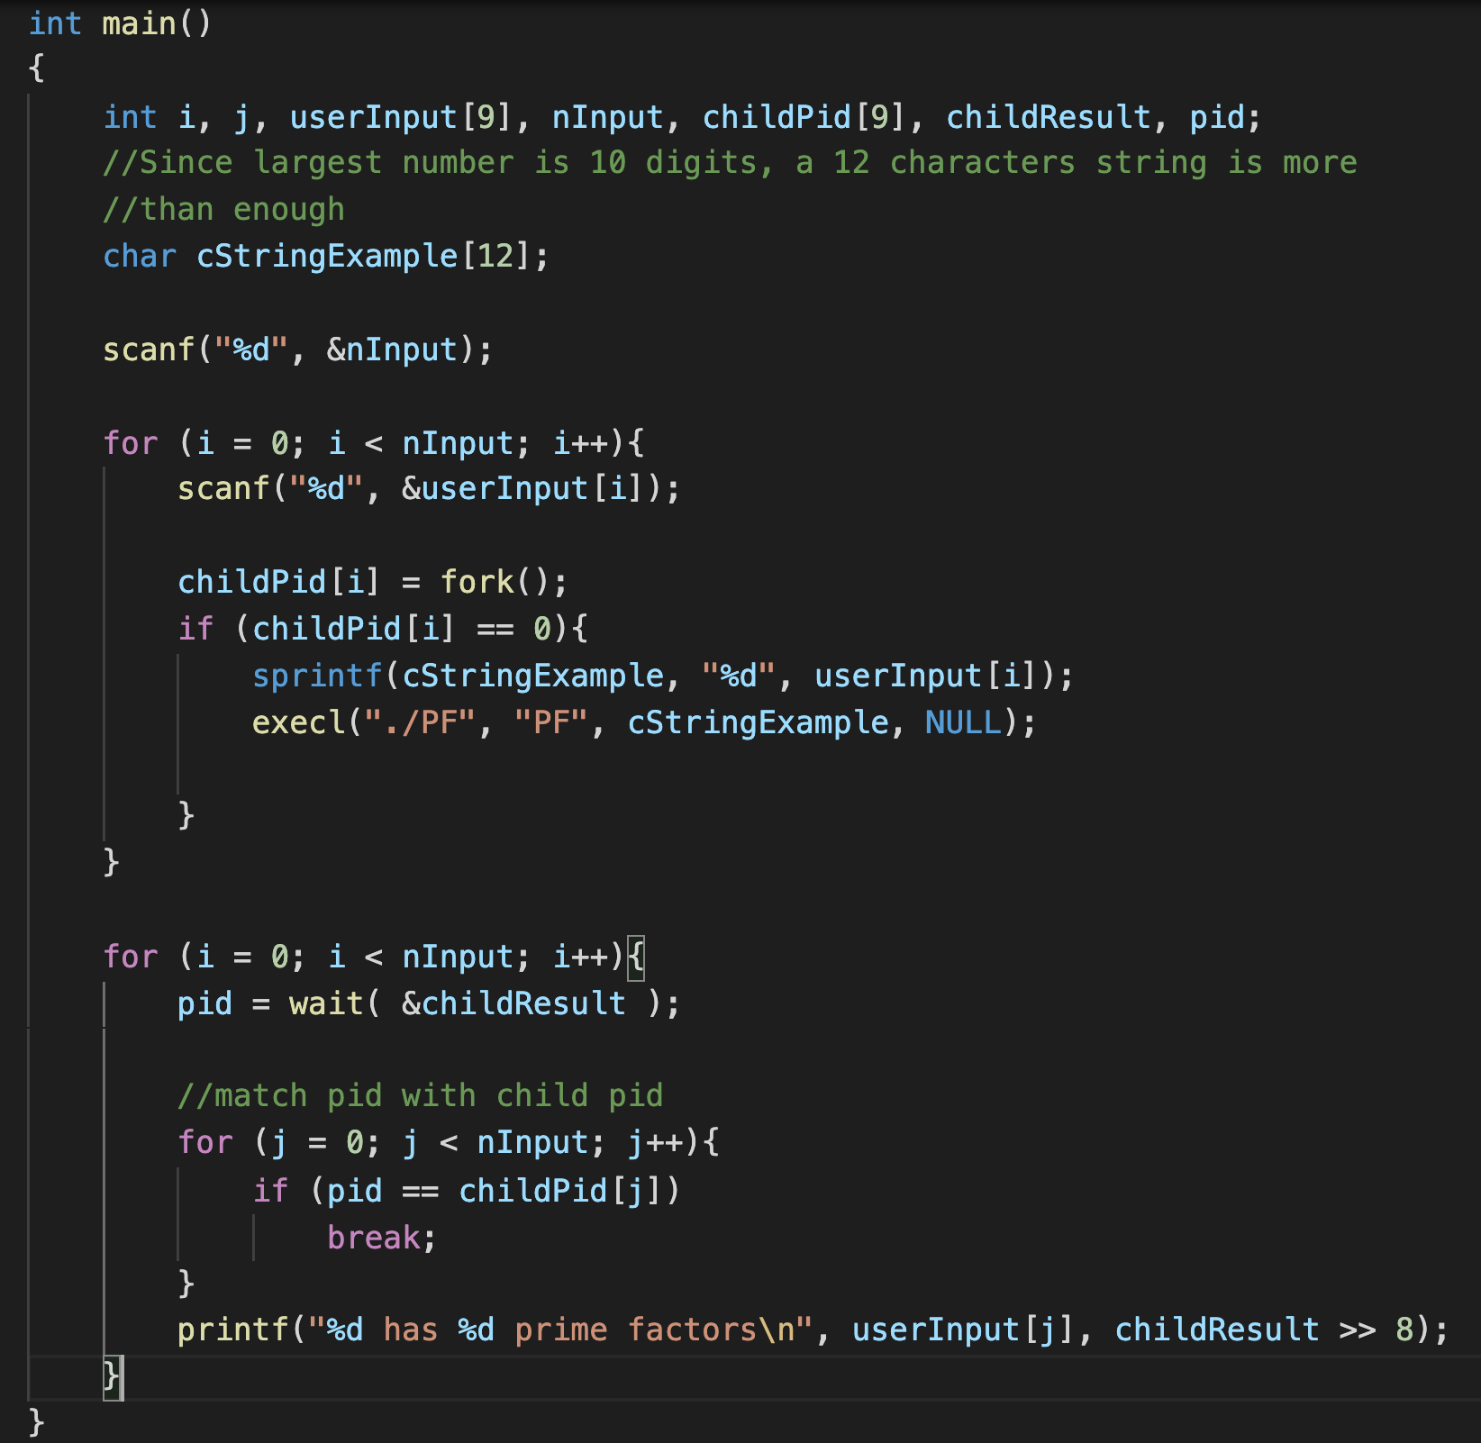
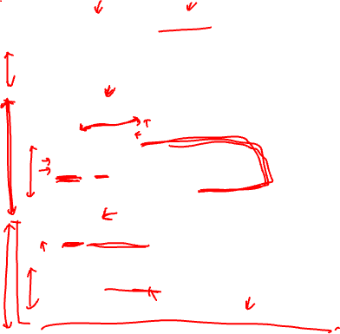
Question 3

Slide 51
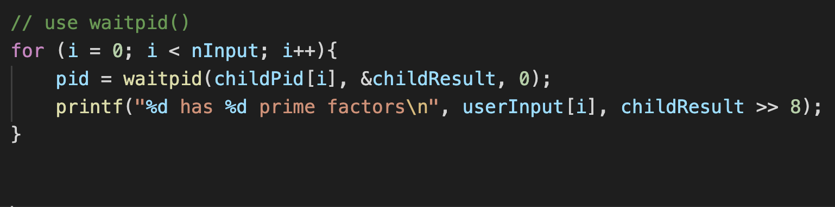
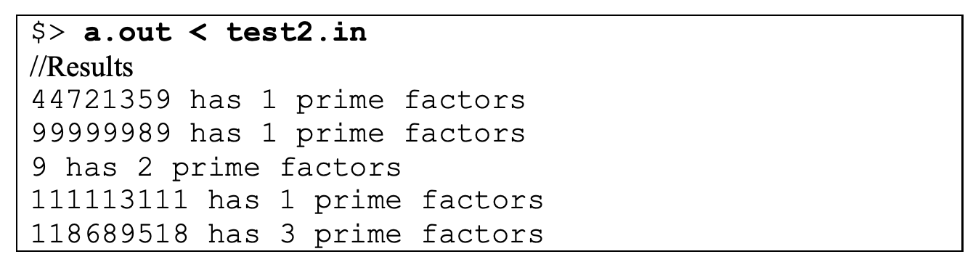
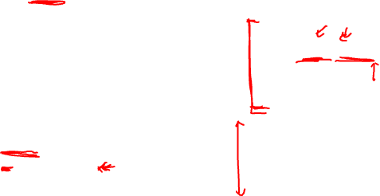
Question 3
waitpid() forces the main process to wait for the child process in certain order, e.g. the creation order of the child processes.
Possible outcome: (faster processes may get to printed later because of creation order)

Slide 52
Question 3
One thing to note:
We are "paying" process spawning overhead to "earn" (real) parallel execution.
If there is only a single processor, or the overhead > earning from parallel execution, the solution will NOT show any improvement.

Slide 53
Thank you!

